Slide 1
Next Generation Automation Architecture for DC Smart Homes
-M.SAI CHAND(14006110)
-B.SIDARATH (14006128)

Slide 2
Abstract
Introduction
DC Nano Grids for Smart Homes
Advantages of DC over AC in building Applications
Power Architecture of DC smart home
Coding
Conclusion

Slide 3
ABSTRACT :
DC nanogrids for residential use are gaining research
interest as an effective solution to integrate several types of
distributed renewable energy resources, energy storage, and DC loads. This paper proposes a novel three-layer automation architecture for the DC nanogrid of future DC “smart” homes . The bottom layer, i.e. the converter level control, is fully decentralized and allows plug & play functionality, without the need for horizontal communication. The middle layer optimizes the usage of energy resources and storage as well as thermal
devices based on a Multi-Agent System. The top layer is the user interface and the communication port to the Energy Network Operator, to enable smart grid capabilities , such as demand side management, demand response, and grid support.

Slide 4
INTRODUCTION :
Power electronics is not only the power interface to renewable energy resources, but also is currently
opening opportunities for safe, efficient, and reliable
generation, transmission, distribution, and consumption
mainly based on DC technology.
To monitor and control the renewable energy resources and storage systems in a DC nanogrid, an automation architecture, supported by information and communication technologies, must be designed. The automation architecture must also be able to monitor and control the building's heating

Slide 5
DC Nano Grids for Smart Homes
considering the fact that most of the electrical appliances as
LED light, computers and variable-speed electrical drives, and
PV generation and storage, need DC, the design of a fully electrical home based on a low voltage DC nanogrid seems to be a very attractive solution.
According to the Passive House and the new German Energy Saving Regulation, these buildings have a very low heating
energy demand between 15 and 25 kWh/m² of net living
space. In these cases, the energy balance of individual room
reacts immediately on internal heat sources or external solar
radiation.

Slide 6
Advantages of DC over AC in building Applications :
DC systems, in principle, offer higher efficiency, higher
flexibility and lower component cost compared with AC
counterpart. The structure of the power system of a house with
AC and with DC distribution is shown in Fig
In a conventional AC home, a rectification stage (marked
in red) is usually required to convert AC to DC for each
load, which is usually relatively bulky, costly, less efficient
and complex to control. Moreover, to feed various loads,
the DC voltage needs to be further stepped down for DC
loads or converted to adjustable AC voltage for AC loads.
In a DC system the rectification stage is not required.

Slide 7
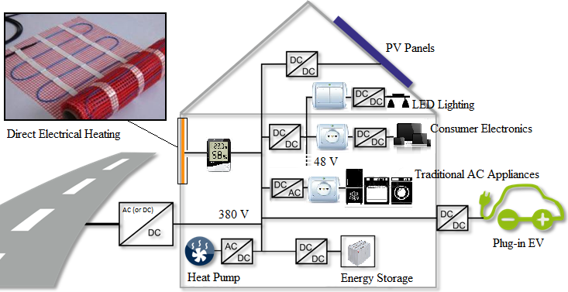
Power Architecture of DC smart home

Slide 8
CONCLUSION: WE ARE THRIVING TO DEVELOP A AUTOMATIC SYSTEM WHICH COULD AUTOMIZE DC SMART HOMES WITH PLUG AND PLAY FUNCTIONALITY.

